Slide 1
Sound Propagation through Regions of Axial Temperature Gradient
R. I. Sujith
Indian Institute of Technology Madras

Slide 2
Background
For a homogeneous constant area duct
If area or gas property
change smoothly
large number of reflections
and transmissions in a duct
composed of a series of
small discontinuities

Slide 3
Background : WKB approximation
Gas properties or duct area changes occur over scales that are long relative to that of the disturbance
Amplitudes rescale to conserve energy flux.
Eg. for a right running wave,

Slide 4
Background : High freq. solution
Similarly,

Slide 5
Background : High freq. solution
For a perfect gas
Assuming no mean flow -> mean pressure is constant. Also γ, R are constants

Slide 6
Equations - Cartesian
Continuity
Momentum
Energy

Slide 7
Linearized equations
Momentum :
Energy :
Wave
Equations
No mean flow!

Slide 8
Solution procedure
Introduce
Bala Subrahmanyam, Sujith & Lieuwen (2001 JSV)

Slide 9
Solution procedure
Reduces to
when
and
constant

Slide 10
Admissible profiles
For an arbitrary temperature profile :
For an arbitrary area profile :

Slide 11
Special cases
Constant area
Constant Temperature
When both vary,
n_{p}= -2m_{p} or n_{p}=-(2m_{p}-4)/3

Slide 12
Acoustic pressure and velocity
Note :

Slide 13
Evolution of a pulse (constant A)

Slide 14
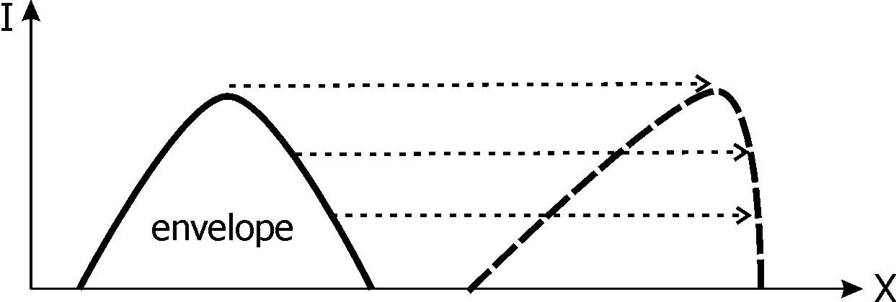
Compression wave-fronts steepen to form shocks

Slide 15
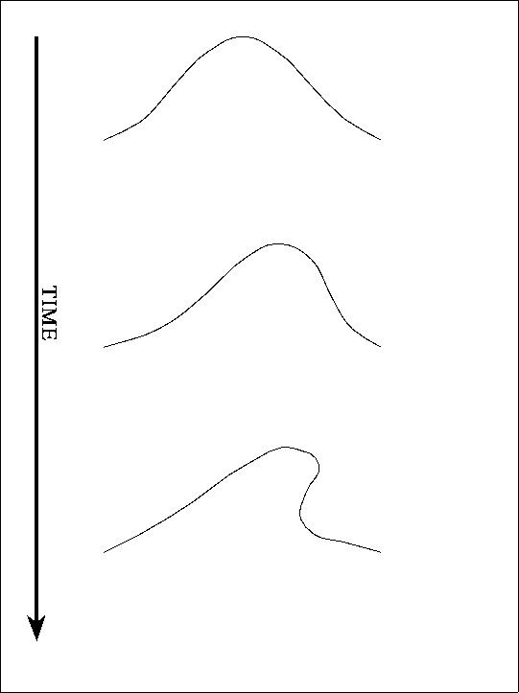

Slide 16
Evolution of a pulse (constant T)

Slide 17
Harmonic solutions
In the absence of mean flow,
Momentum :
Energy
Wave equation :
Sujith, Waldherr, Zinn (JSV 1995)

Slide 18
Harmonic solutions
A little trick!

Slide 19
Linear Temperature Profile
Eq. reduces to
where

Slide 20
Bessel’s Differential Equation

Slide 21
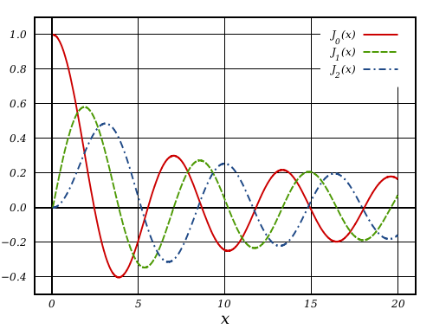
Acknowledgement: Wikipidea

Slide 22
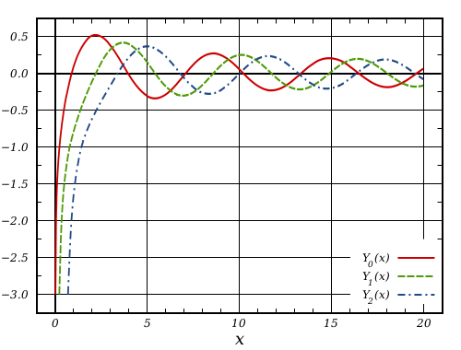
Acknowledgement: Wikipidea

Slide 23
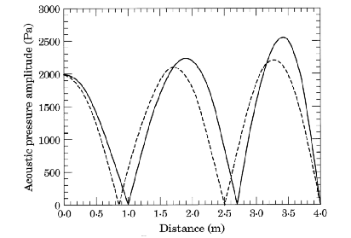
Acoustic pressure amplitude
-----T₁=500 K, m = -50 K/m; T₁=1100K, m = -200 K/m

Slide 24
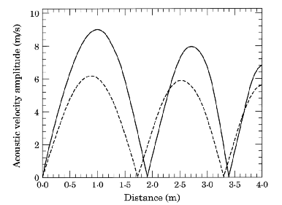
Acoustic velocity amplitude
-----T₁=500 K, m = -50 K/m; T₁=1100K, m = -200 K/m

Slide 25
Exponential temperature profile

